Slide 1
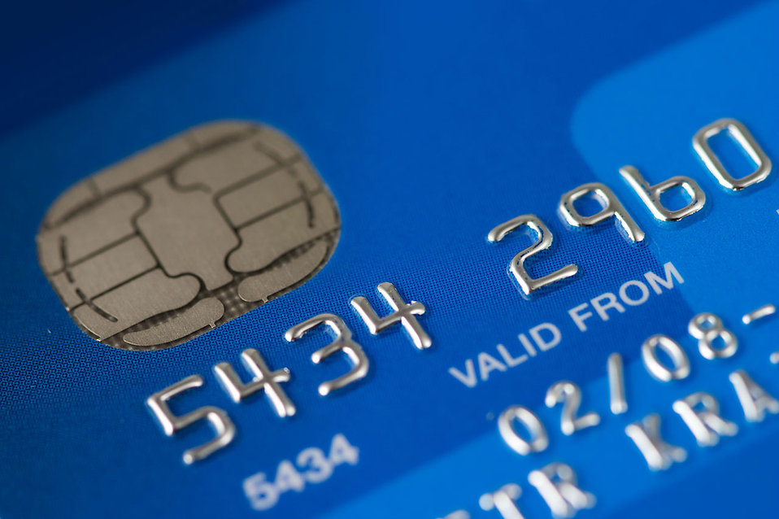
Credit Card Fraud
Erik Fryanov | Chris Nam | Benjamin Trenery

Slide 2
Background of Credit Cards
In the U.S., 84% of the adult population has at least one credit card
That is about 572 million total credit cards
They are used in the place of cash for transactions
It works by establishing a line of credit with the bank
Credit is a form of borrowing where one can borrow upto a maximum limit set by the bank, which the person will pay back at the end of each month
This method of transaction can be convenient due to not needing to hold onto as much cash on one’s person and instead can use a credit card
It can be dangerous however if a credit card is stolen

Slide 3
Dangers of a Stolen Credit Card
When a credit card is stolen and used, this is called credit card fraud
Due to the ability for a person to spend up to the maximum threshold amount, a thief can spend a lot of money using a stolen credit card
Some ways a credit card can be stolen include
physically stealing the card, using a skimming device in public places like gas stations, and hacking into financial databases
For the person whose credit card has been stolen
Unauthorized charges, identity theft, and reduce their credit card score
For banks
For credit card users, they given some protection against unwanted charges from the bank
The bank is liable to pay for the credit without reimbursement
This means that the bank have to use their money to pay off the charges from the credit card
It can also lead to needing police investigations into the matter

Slide 4
Reasons for this project
As shown, credit cards are a common transactional tool for adults
Due to the prevalence in society, this means there will be many thieves trying to steal credit cards
It is important to be able to detect credit card fraud to protect credit card users and limit the losses from the bank
With the utilization of machine learning and AI, models have been developed in order to detect when credit card fraud occurs
This project will utilize one common model for how this is done

Slide 5
Current Solutions
Rule Based System
Anomaly Detection
Predictive Model Systems

Slide 6
Rule Based Systems
Rule-based systems are a foundational approach in detecting fraud. They work by applying a set of pre-established rules to identify potentially fraudulent transactions.
These rules include criteria like transaction amounts that exceed a certain limit, transactions from unfamiliar locations, or rapid frequency of transactions.
While great in identifying known fraud patterns, these systems can sometimes have problems in detecting new and evolving types of fraud.

Slide 7
Anomaly Detection
Anomaly detection is a more advanced way to find fraud. It uses special algorithms to notice when a transaction is different from what a person usually does.
For example, if someone suddenly spends a lot more money than usual, or in a place they don't usually shop, the system might flag this as unusual.
This method keeps learning and getting better over time, so it's good at catching new and complicated types of fraud

Slide 8
Predictive Model Systems
Predictive models are at the forefront of fighting fraud. They use past information about fraud and current transaction data to guess if a new transaction might be fraud.
These models get smarter over time, learning from new data to become better at spotting fraud.
What's important is that they work fast, spotting possible fraud right as it happens, so we can act quickly.

Slide 9
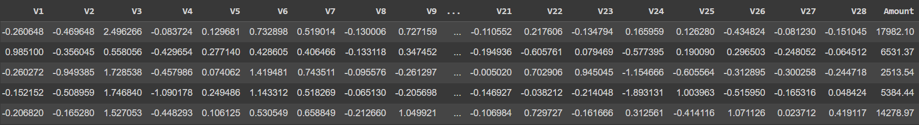
The Data
The dataset is here is a credit card fraud detection dataset in 2023 and it has 28 distinct features, identified as V1 through V28.
It contains various metadata like where and when each purchase was made.
To protect people's privacy, the dataset uses non-specific details, so personal information stays private.

Slide 10
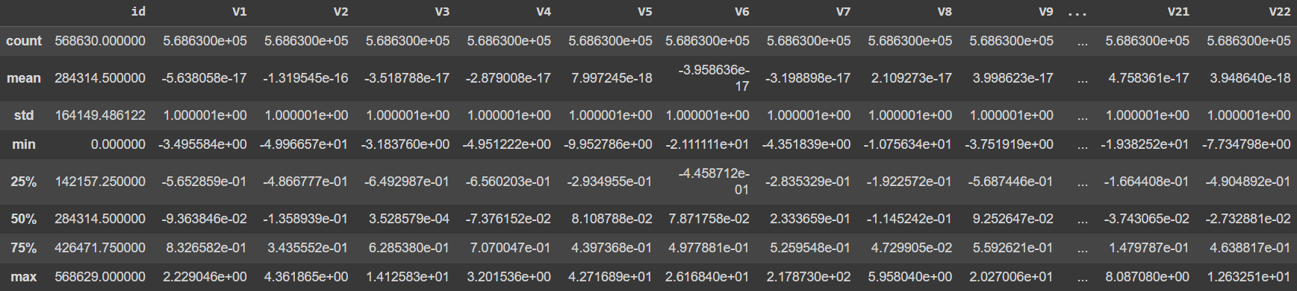
Normally Distributed?
Looking at statistics of the dataset before processing revealed key features were normally distributed/standardized.
However…

Slide 11
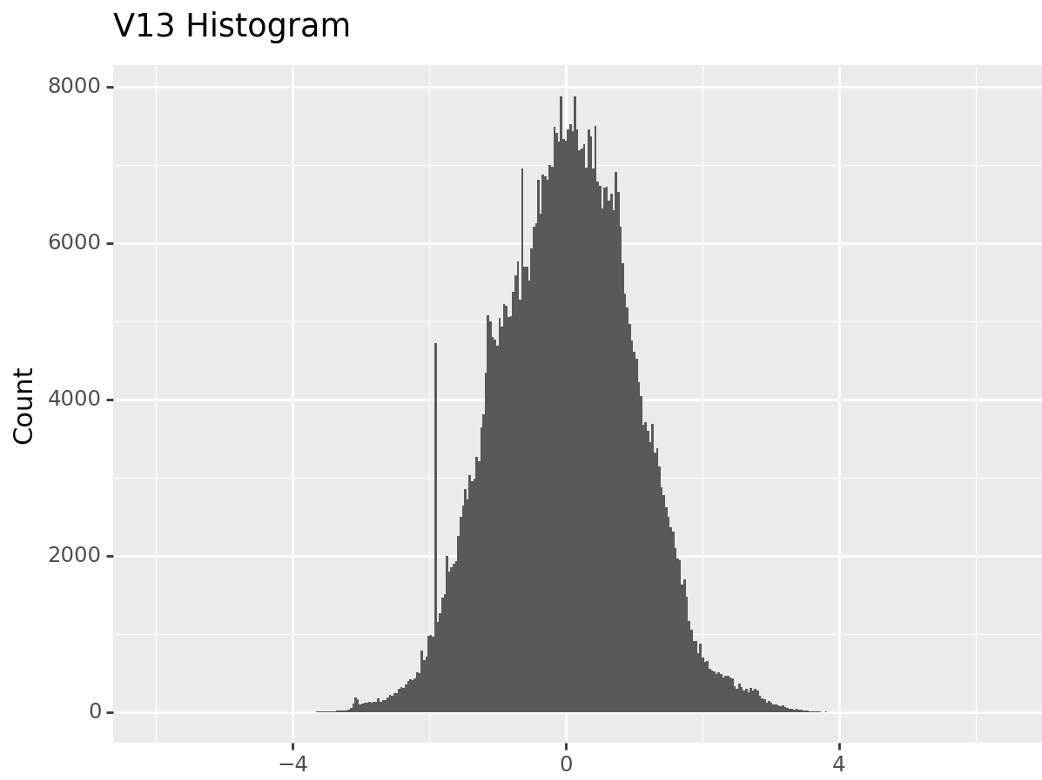
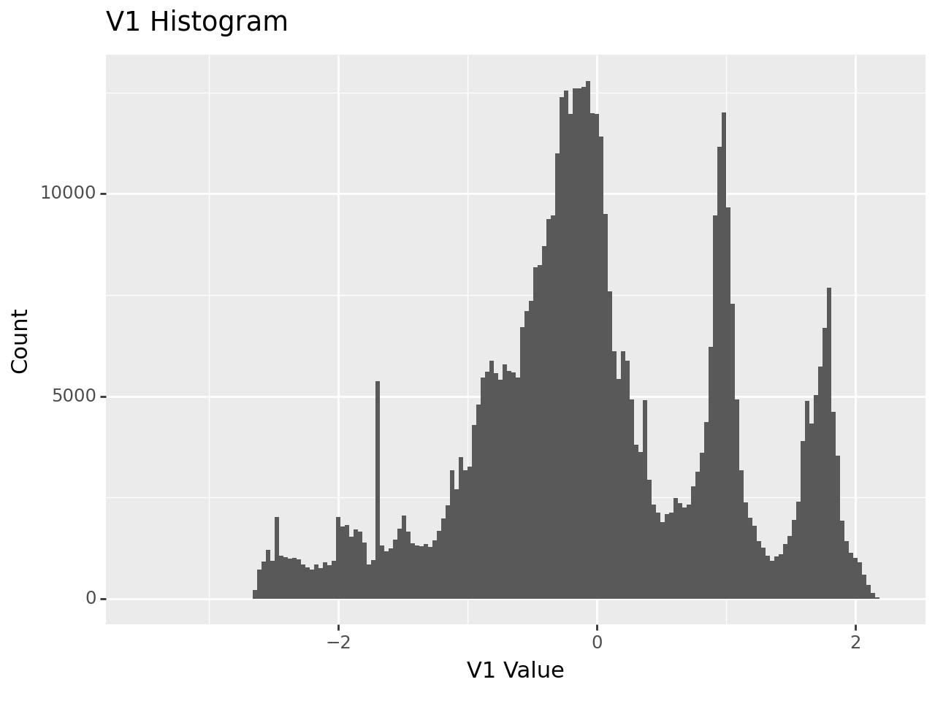
Histogram Distributions
Histogram distributions showed some had good normal distribution, while others were more skewed. → Dataset was standardized regardless in preprocessing.

Slide 12
Binary Classification in Fraud Detection
This dataset uses a simple method called binary classification to sort transactions.
Transactions are labeled as “0” if they seem normal (non-fraudulent) and “1” if they seem unusual (fraudulent).
This method helps quickly identify which transactions need a closer look for possible fraud.

Slide 13
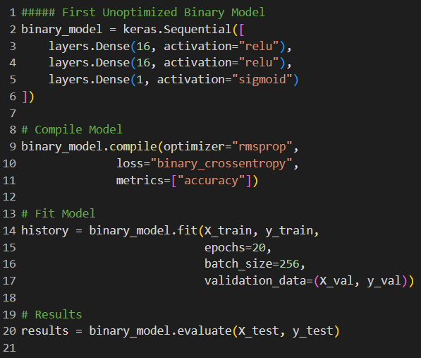
First Feed Forward Model
Achieve initial baseline for comparison.
Relatively unoptimized.
Achieves test loss and accuracy of 0.009 and 99.79% respectively.
Note: Basic logistic regression model achieves 96.82% accuracy.

Slide 14
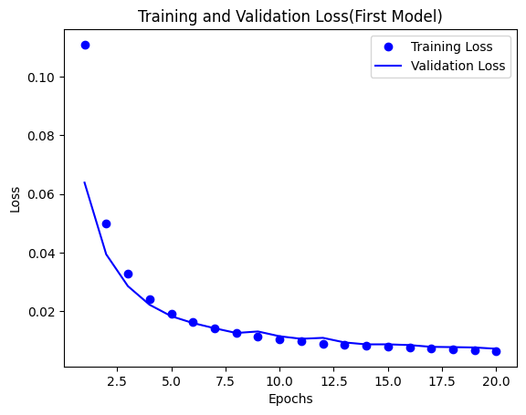
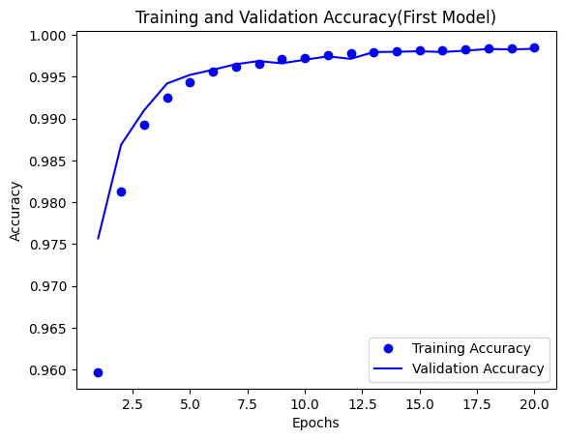
Figure 1 - Training and Validation Loss Overtime(First)
Figure 1.1 - Training and Validation Accuracy Overtime(First)

Slide 15
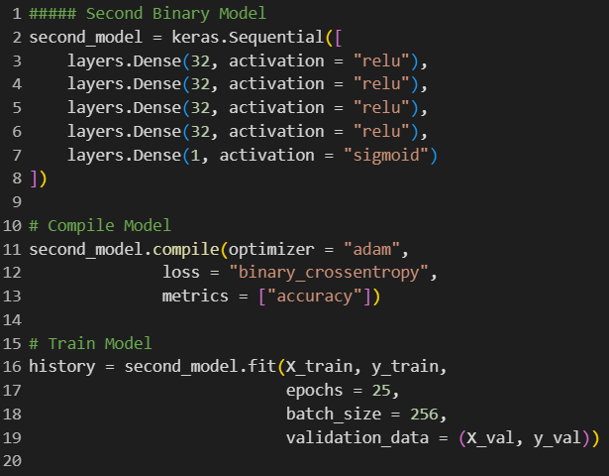
Second Model
Test Loss: 0.003
Test Accuracy: 99.92%
Roughly same compute time.
No regularization applied due to lack of overfitting.

Slide 16
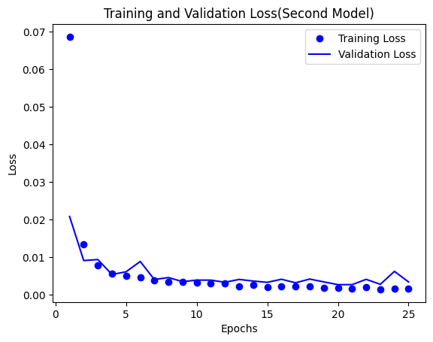
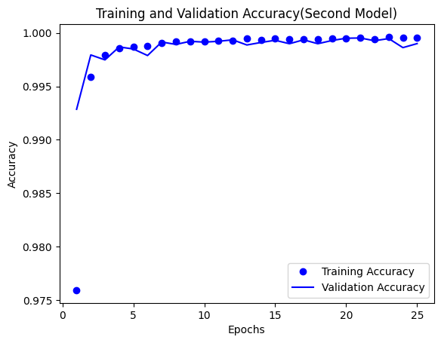
Figure 2 - Training and Validation Loss Overtime(Second)
Figure 2.1 - Training and Validation Accuracy Overtime(Second)

Slide 17
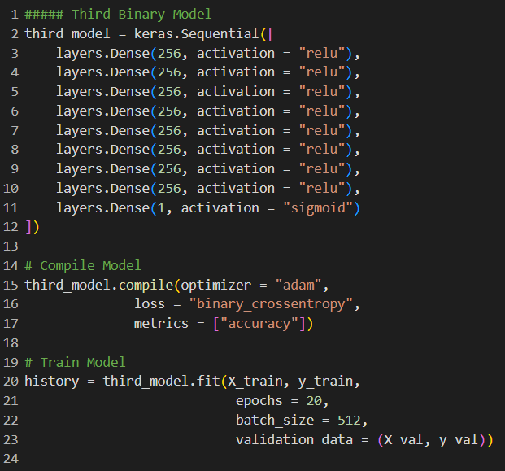
Third Model
Test Loss: 0.002
Test Accuracy: 99.95%
Much longer compute time.

Slide 18
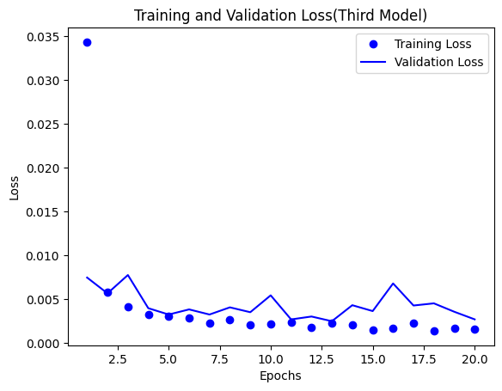
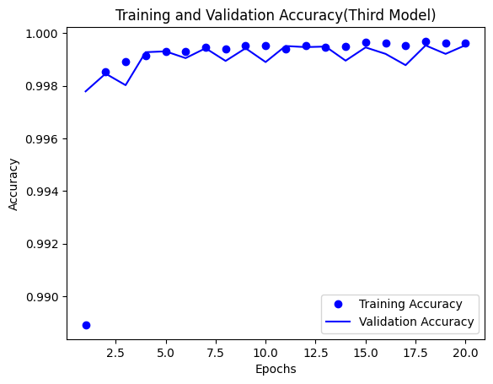
Figure 3 - Training and Validation Loss Overtime(Third)
Figure 3.1 - Training and Validation Accuracy Overtime(Third)

Slide 19
Insights from Initial Models
Large amount of training data prevents model from being able to overfit, but allows it to learn effectively.
Increasing model complexity provides very minimal performance improvements.
Final Model Objective: Create a balanced model of complexity and speed to allow for real time detection with very high accuracy.
Target Accuracy → 99.9%

Slide 20
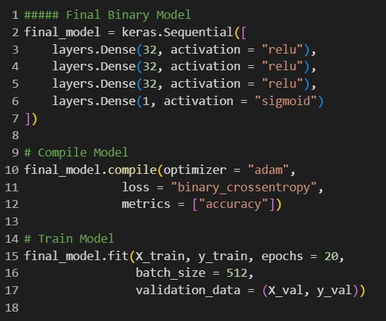
Final Model
Test Loss: 0.002
Test Accuracy: 99.95%
Similar performance to third model, but with greatly reduced complexity and faster prediction time.
Prediction Time: ~5 seconds for entire test dataset

Slide 21
Regularization?
Regularization generally didn’t help with model performance.
Three versions applied:
Dropout + L1 → Most aggressive regularization
Dropout + L2 → Less aggressive
Dropout Only → Least aggressive
All three reduced model performance and increased prediction time from 2-4 seconds.

Slide 22
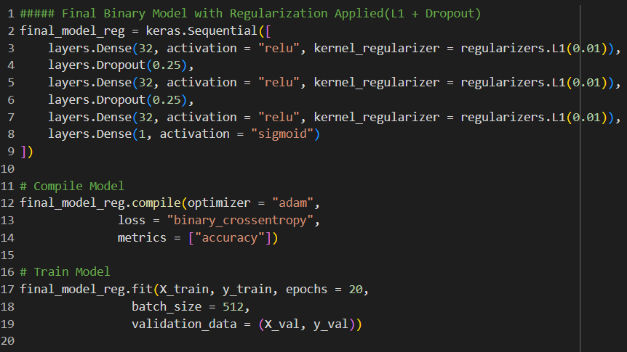
Dropout + L1

Slide 23
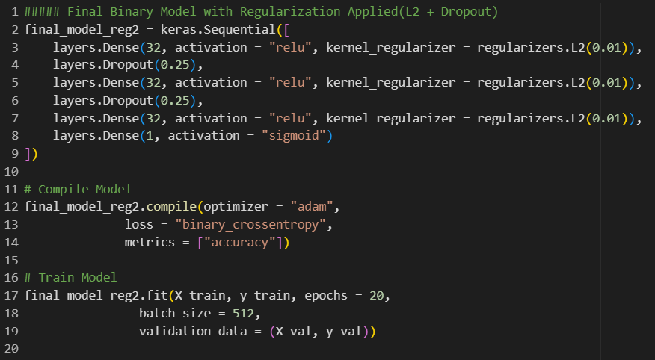
Dropout + L2

Slide 24
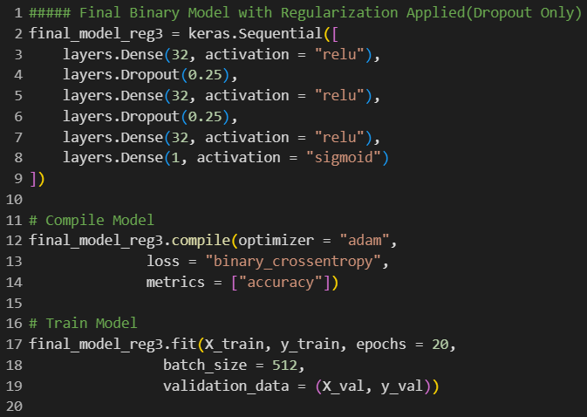
Dropout Only

Slide 25
Future Improvements + Implications?
Model is capable of real time detection(5 seconds for entire test set)
In terms of improvements, analyze other performance metrics to identify if there is an imbalance between fraud or not fraud being detected.
Further speed up prediction time while retaining high performance.

Slide 26
Sources:
Radage, Kalle. “Credit Card Fraud in 2023.” Credit Card Processing and Merchant Account, Clearly Payments, 13 Aug. 2023, www.clearlypayments.com/blog/credit-card-fraud-in-2023/#:~:text=Year%20after%20year%2C%20credit%20card,attempted%20fraud%20transactions%20follows%20suit.
White, Alexandria. “Here’s How Credit Card Fraud Happens and Tips to Protect Yourself.” CNBC, CNBC, 25 Sept. 2023, www.cnbc.com/select/credit-card-fraud/.
Balaban, Daniella. “Top 10 Credit Card Fraud Detection Solutions in 2023.” CybeReady, CybeReady, 3 May 2023, cybeready.com/top-10-credit-card-fraud-detection-solutions-in-2023#:~:text=Predictive%20modeling%20systems%20use%20advanced,specific%20types%20of%20fraudulent%20activities.
Kovalenko, Olena. “Credit Card Fraud Detection Using Machine Learning: SPD Technology.” SPD Technology, SPD Technology, 28 Sept. 2023, spd.tech/machine-learning/credit-card-fraud-detection/#:~:text=Unsupervised%20Machine%20Learning%20methods%20use,by%20similarities%20without%20manual%20labeling.
Hare, Valerie. “The Cost of Credit Card Fraud.” Tokenex, tokenex, 11 Oct. 2022, www.tokenex.com/blog/vh-the-cost-of-credit-card-fraud/
Dataset: https://www.kaggle.com/datasets/nelgiriyewithana/credit-card-fraud-detection-dataset-2023

